Slide 1




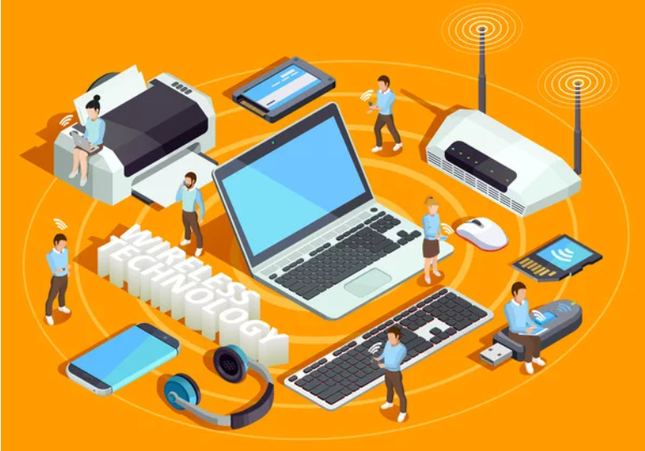




Understanding the Basics of Networking
Presented To:
Abdullah Al-Amin
Lecturer
Department Of CSE,
Daffodil International University
Presented By:
Nurjahan Akther Mim 221-15-4782
Abu Zahed 221-15-4716
Md Amir Hamja 221-15-4784
Arnub Datta 221-15-4726
Fatema Akter Priya 221-15-4765
Section: 61_L Department Of CSE

Slide 2





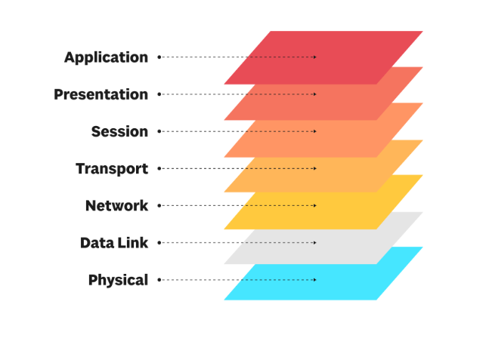

OSI Model
Our Vision
OSI Model is a seven-layer framework that standardizes how devices communicate over a network, enhancing compatibility and troubleshooting. Each layer has a specific role:
Physical: Manages physical connections.
Data Link: node-to-node data transfer.
Network: Routes data between networks.
Transport: reliable data transfer.
Session: Manages sessions between applications.
Presentation: Formats and encrypts data.
Application: Supports end-user

Slide 3
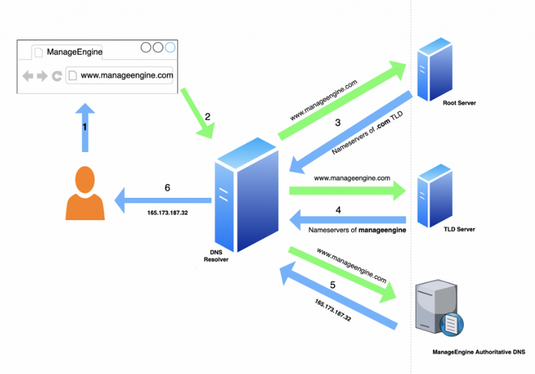
DNS (Domain Name System)
The Domain Name System (DNS) is a fundamental technology that makes it easy to navigate the internet by converting human-friendly domain names (like www.google.com) into IP addresses (like 172.217.0.46) that computers use to identify each other.
key points:
Domain Name Resolution: Translates domain names to IP addresses.
Caching: Speeds up requests by storing data at various levels.
Distributed System: Decentralized structure for scalability.
Record Types: Includes A, AAAA, MX, CNAME, and TXT records.
Security (DNSSEC): Protects against spoofing attacks with cryptographic signatures.
Multi-Service Support: Directs websites, emails, and more.

Slide 4
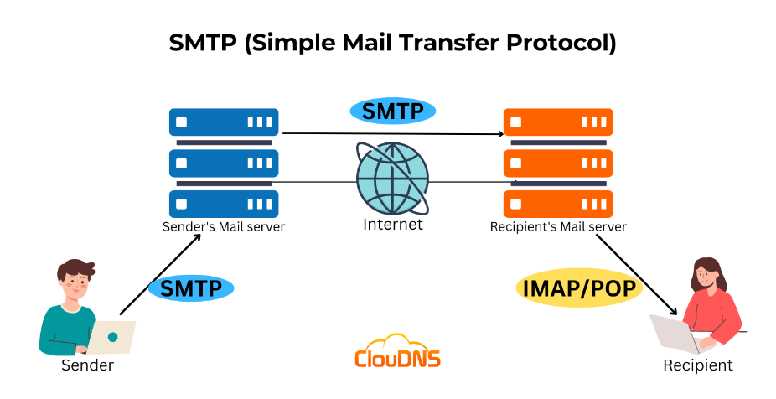
SMTP (Simple Mail Transfer Protocol)
Our Vision
SMTP (Simple Mail Transfer Protocol) is a standard protocol used for sending and transferring emails across the internet. Operating at the Application Layer, it enables email servers to send, receive, and relay messages to and from clients and other servers.
Key Points:
Function: Designed for sending emails.
Transport: Uses TCP, usually on port 25.
Commands: Key commands are HELO, MAIL FROM, RCPT TO, and DATA.
Relaying: Routes emails across domains.
Security: Supports authentication and encryption (e.g., STARTTLS).

Slide 5
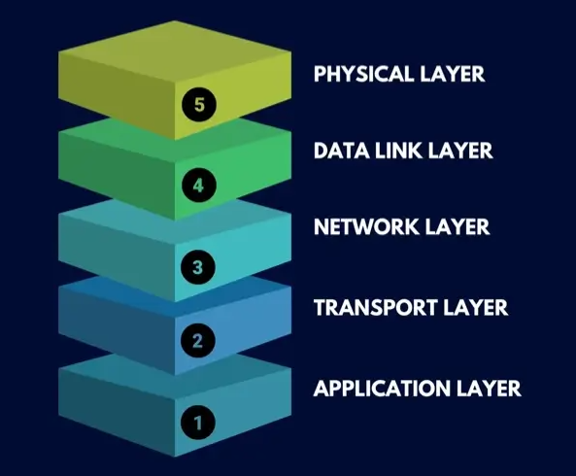
TCP/IP Model
TCP/IP (Transmission Control Protocol/Internet Protocol) is a set of protocols that enables communication over the internet, managing data transmission, addressing, and routing between devices. It consists of layers that ensure reliable and efficient data exchange.
TCP/IP Layers:
Application Layer: User-facing protocols (HTTP, FTP, SMTP).
Transport Layer: Reliable data transfer (TCP, UDP).
Network Layer: Routing and addressing (IP).
Data Link Layer: Node-to-node data transfer (Ethernet, Wi-Fi).
Physical Layer: Physical transmission of bits (cables, signals).

Slide 6
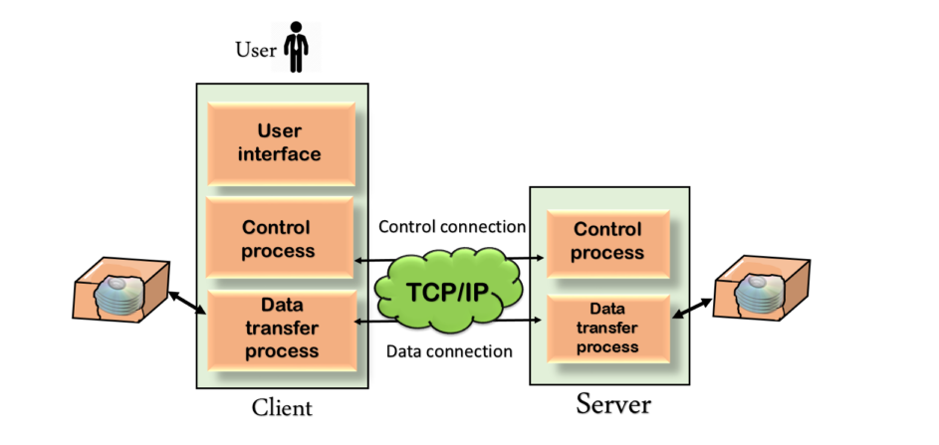
FTP (FileTransfer Protocol)
Our Vision
FTP (File Transfer Protocol) is a standard network protocol used for transferring files between a client and a server over a TCP/IP network. It allows users to upload, download, and manage files on remote servers efficiently.
Key Points:
Purpose: Transfers files between client and server.
Modes: Operates in active and passive modes.
Functions: Allows file upload, download, and management.
Security: Standard FTP is unencrypted; FTPS and SFTP are secure alternatives.
Uses: Commonly used for website management, file sharing, and backups

Slide 7


THANK YOU!😀

